Slide 1
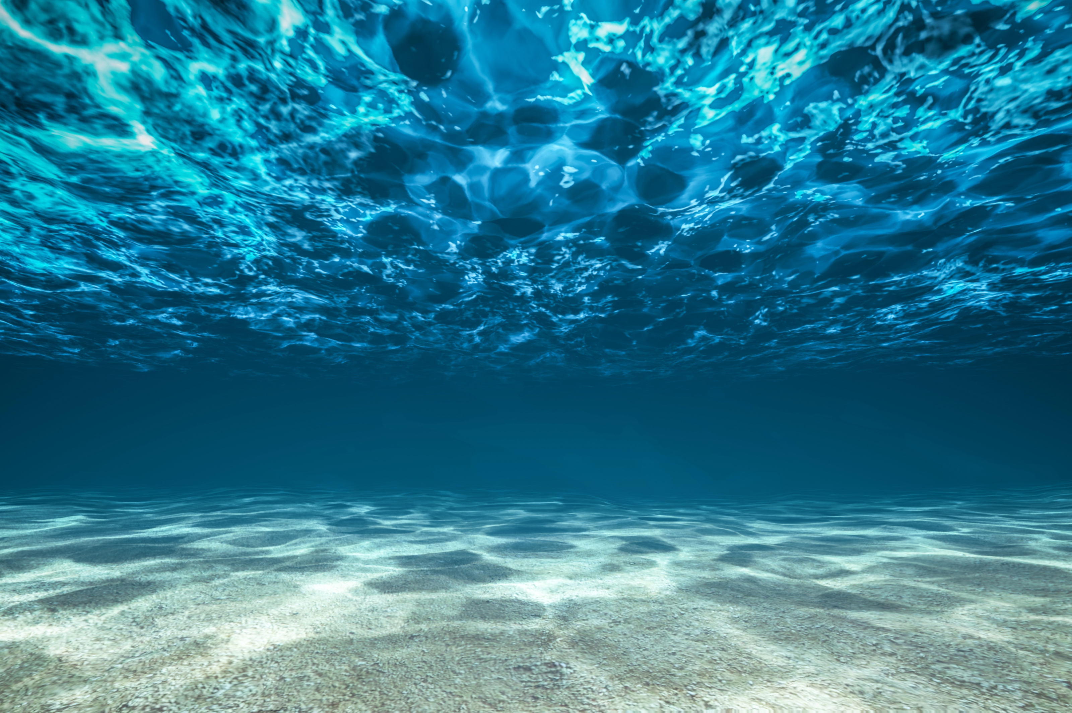
Testbed for IoUT
Felipe Bahamondes, Mathias Markvardsen, Morten Henriksen

Slide 2
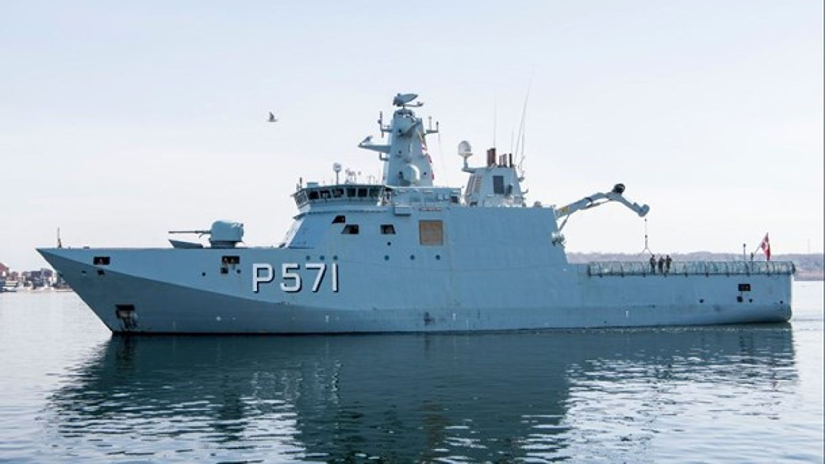
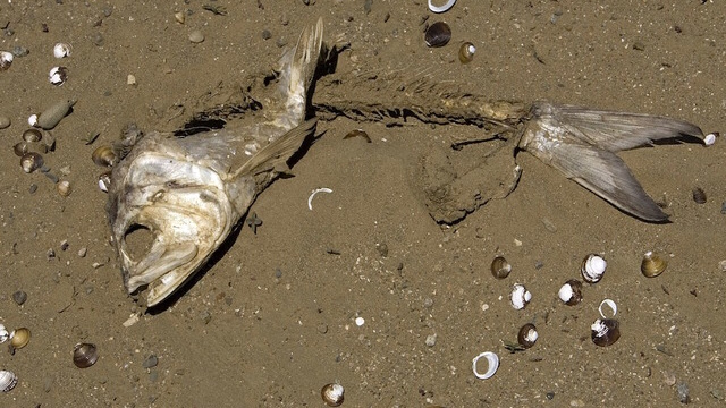
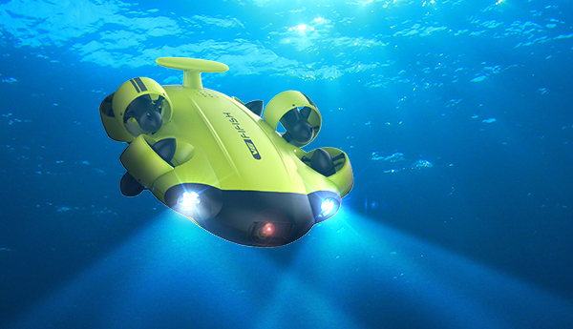
Motivation
To facilitate a test bed that will act as reference frame for researchers to compare their innovations

Slide 3
Story line
Intro & motivation – what are we doing, who are we
Play .wav file of funny msg

Slide 4
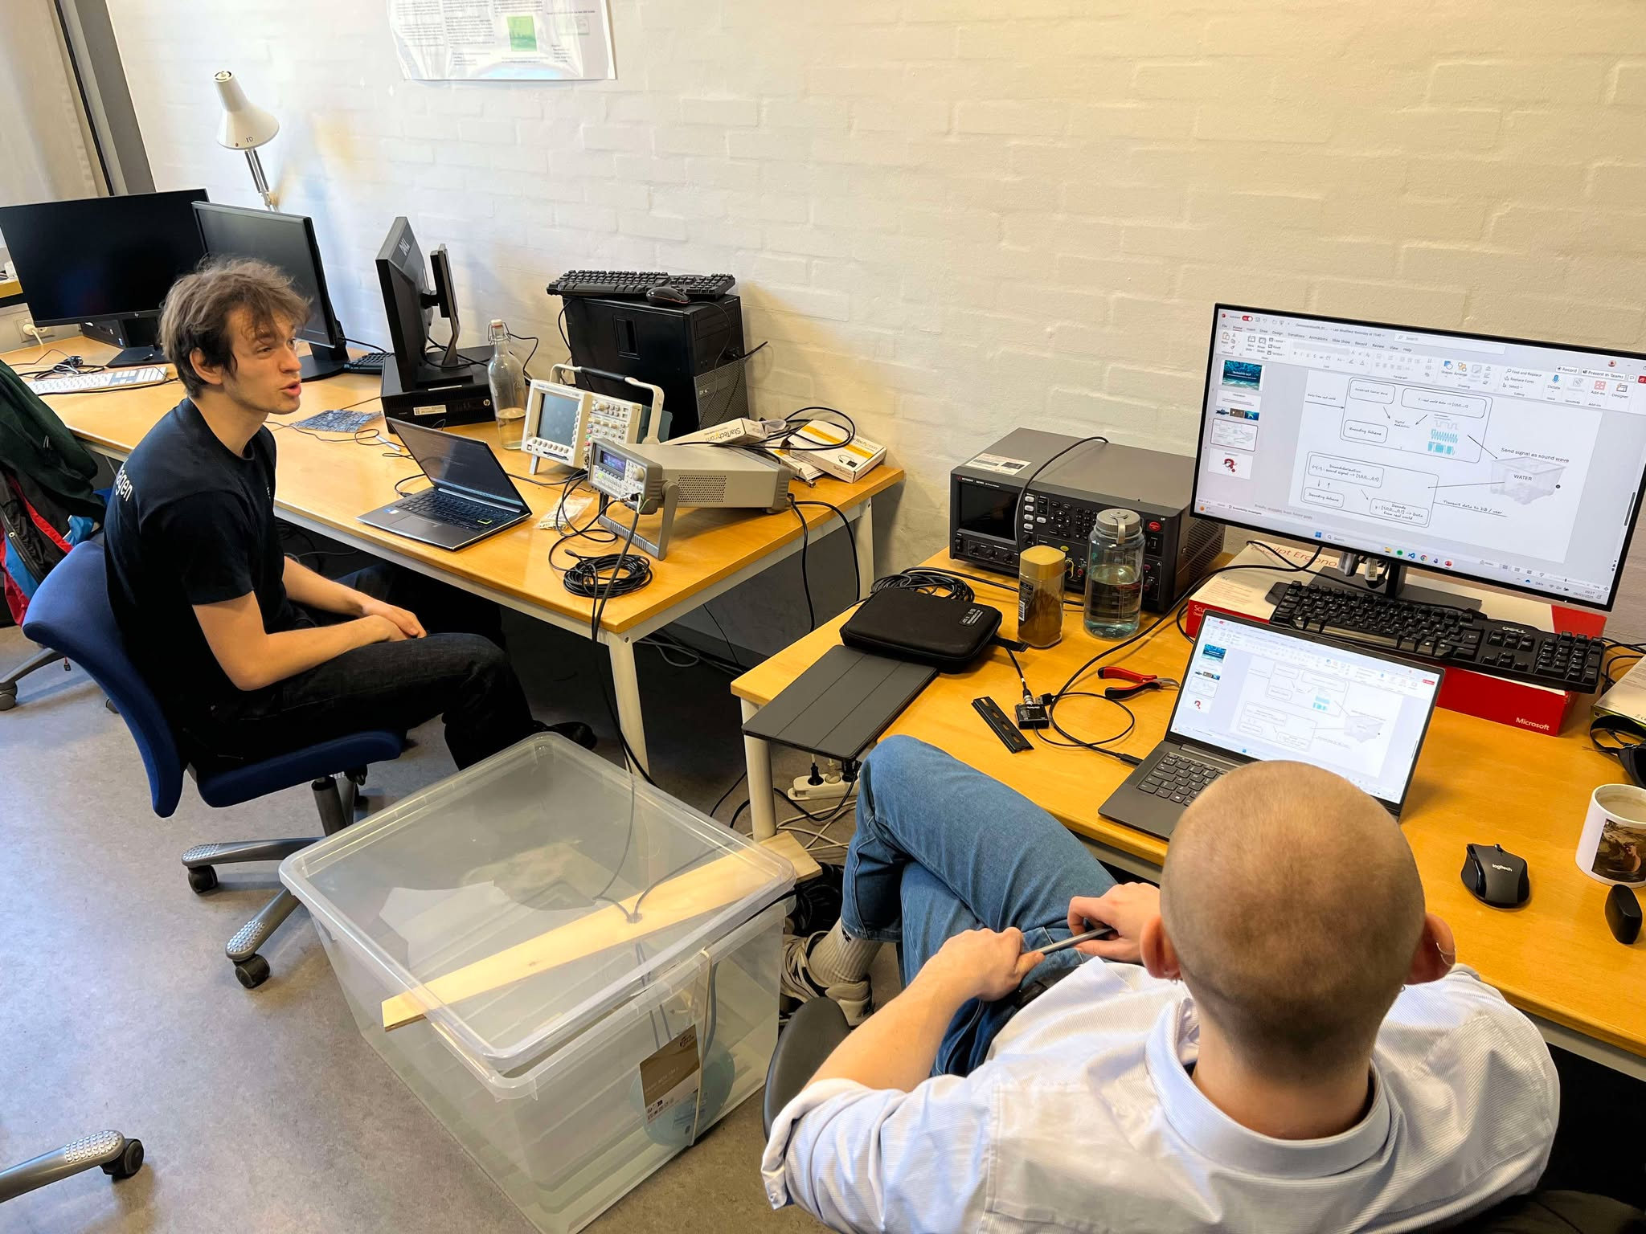

Questions?

